Slide 1
As of March 31, 2025
A PORTFOLIO OF POWERFUL COMPANIES
FY25 Q4 Update
NASDAQ: AIRT

Slide 2
Statements in this document, which contain more than historical information, may be considered forward-looking statements (as such term is defined in the Private Securities Litigation Reform Act of 1995), which are subject to risks and uncertainties. Actual results may differ materially from those expressed in the forward-looking statements because of important potential risks and uncertainties, including, but not limited to, economic and industry conditions in the Company’s markets, the risk that contracts with FedEx could be terminated or adversely modified, the risk that the number of aircraft operated for FedEx will be reduced, the risk that GGS customers will defer or reduce significant orders for deicing equipment, the impact of any terrorist activities on United States soil or abroad; the Company’s ability to manage its cost structure for operating expenses, or unanticipated capital requirements, and match them to shifting customer service requirements and production volume levels, the Company's ability to meet debt service covenants and to refinance existing debt obligations, the risk of injury or other damage arising from accidents involving the Company’s overnight air cargo operations, equipment or parts sold and/or services provided, market acceptance of the Company’s commercial and military equipment and services, competition from other providers of similar equipment and services, changes in government regulation and technology, changes in the value of marketable securities held as investments, mild winter weather conditions reducing the demand for deicing equipment, and market acceptance and operational success of the Company’s relatively new aircraft asset management business and related aircraft capital joint venture. A forward-looking statement is neither a prediction nor a guarantee of future events or circumstances, and those future events or circumstances may not occur. The Company is under no obligation, and it expressly disclaims any obligation, to update or alter any forward-looking statements, whether as a result of new information, future events or otherwise. Potential investors should review the Company’s risk factors contained in its reports filed with the Securities and Exchange Commission, as well as the summary Risk Factors contained herein, prior to investing.
SAFE HARBOR
Notes:
Boiler plate language

Slide 3
WHO WE ARE
AIR T, INC. (NASDAQ: AIRT) is an industrious American company focusing on growing intrinsic value per share at a high rate.
Founded in 1980, our businesses have a history of growth and cash flow generation.
Current management has been in place since 2013.
The two largest shareholders own, in the aggregate, approximately 67% of the outstanding common stock and have seats on the Board of Directors.
EXECUTIVE
SUMMARY
OPERATING HIGHLIGHTS
AIR T, INC. operates 16 companies with 600+ employees.
For the fiscal year ended 3/31/2025, Revenues were $291.9 million, and Adjusted EBITDA was $7.4 million.
Since 9/30/13, shares outstanding have declined from 3.7m* to 2.8m or 23.2%.
*Adjusted for 3/2 stock split
Notes:
Who we are will remain unchanged – operating highlights should be amended, just done at end of fiscal yr.

Slide 4
About AIR T, INC.
Performance
Our Growth Strategies
Appendix - Risk Factors
CONTENTS
Notes:
Amend based on structure of new presentation.

Slide 5
ABOUT AIR T, INC.

Slide 6
We are an industrious American company established 40+ years and growing.
Our businesses have a history of growth and cash flow generation.
We seek to identify and empower individuals and teams who will operate businesses well, increasing value over time.
We work to activate growth and overcome challenges, ultimately building businesses that flourish over the long term.
Management has repurchased AIRT common stock in the open market, demonstrating real alignment with all common shareholders. As of 03/31/25, our treasury stock was $6.4M.
AIRT’s management team has a track record of successfully allocating capital.
Notes:
This seems to be able to be reused throughout various iterations of the presentation – amend with Treasury Stock Update. Aside from that, the rest of the language seems to be able to be replicated in future iterations. Quarterly update needed.

Slide 7
“Investor-Operator Partnership” is designed to drive short and long-term value creation.
“We want our businesses to be managed by dynamic individuals within high-performance teams. We are set up to make space for dynamos and support their enterprises. The holding company team seeks to focus resources, activate growth and deliver long-term value for everyone associated with AIR T, INC.”
- Nick Swenson
Notes:
Same comment as previous slide – can be used in future iterations of this presentation if we feel it is a value add slide

Slide 8
Identify good ideas
Build a brand and industrious network
Match with capital partners
FLYWHEEL
Generate extremely attractive returns on capital
Secure and empower dynamic management
8
Notes:
Same comment – not being pulled from Q report – but able to use in future iterations

Slide 9
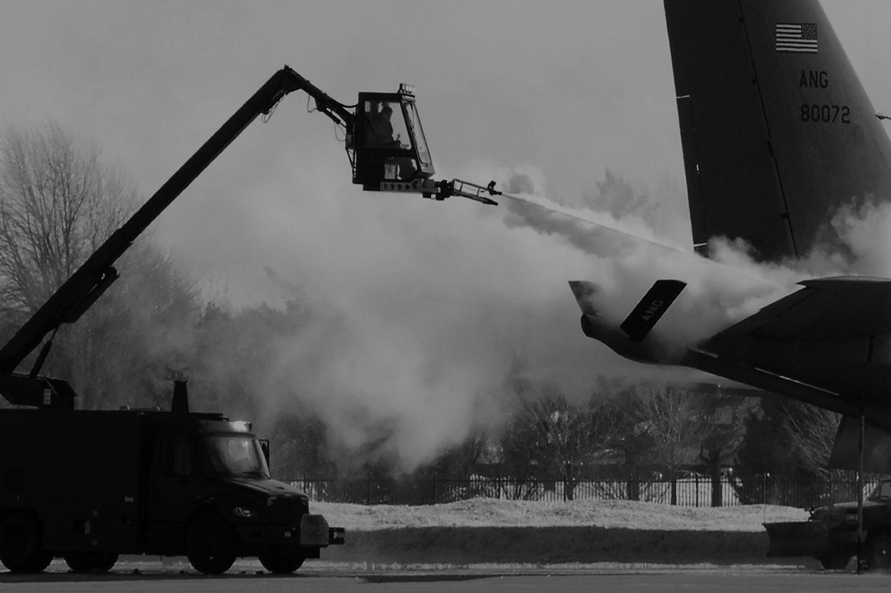
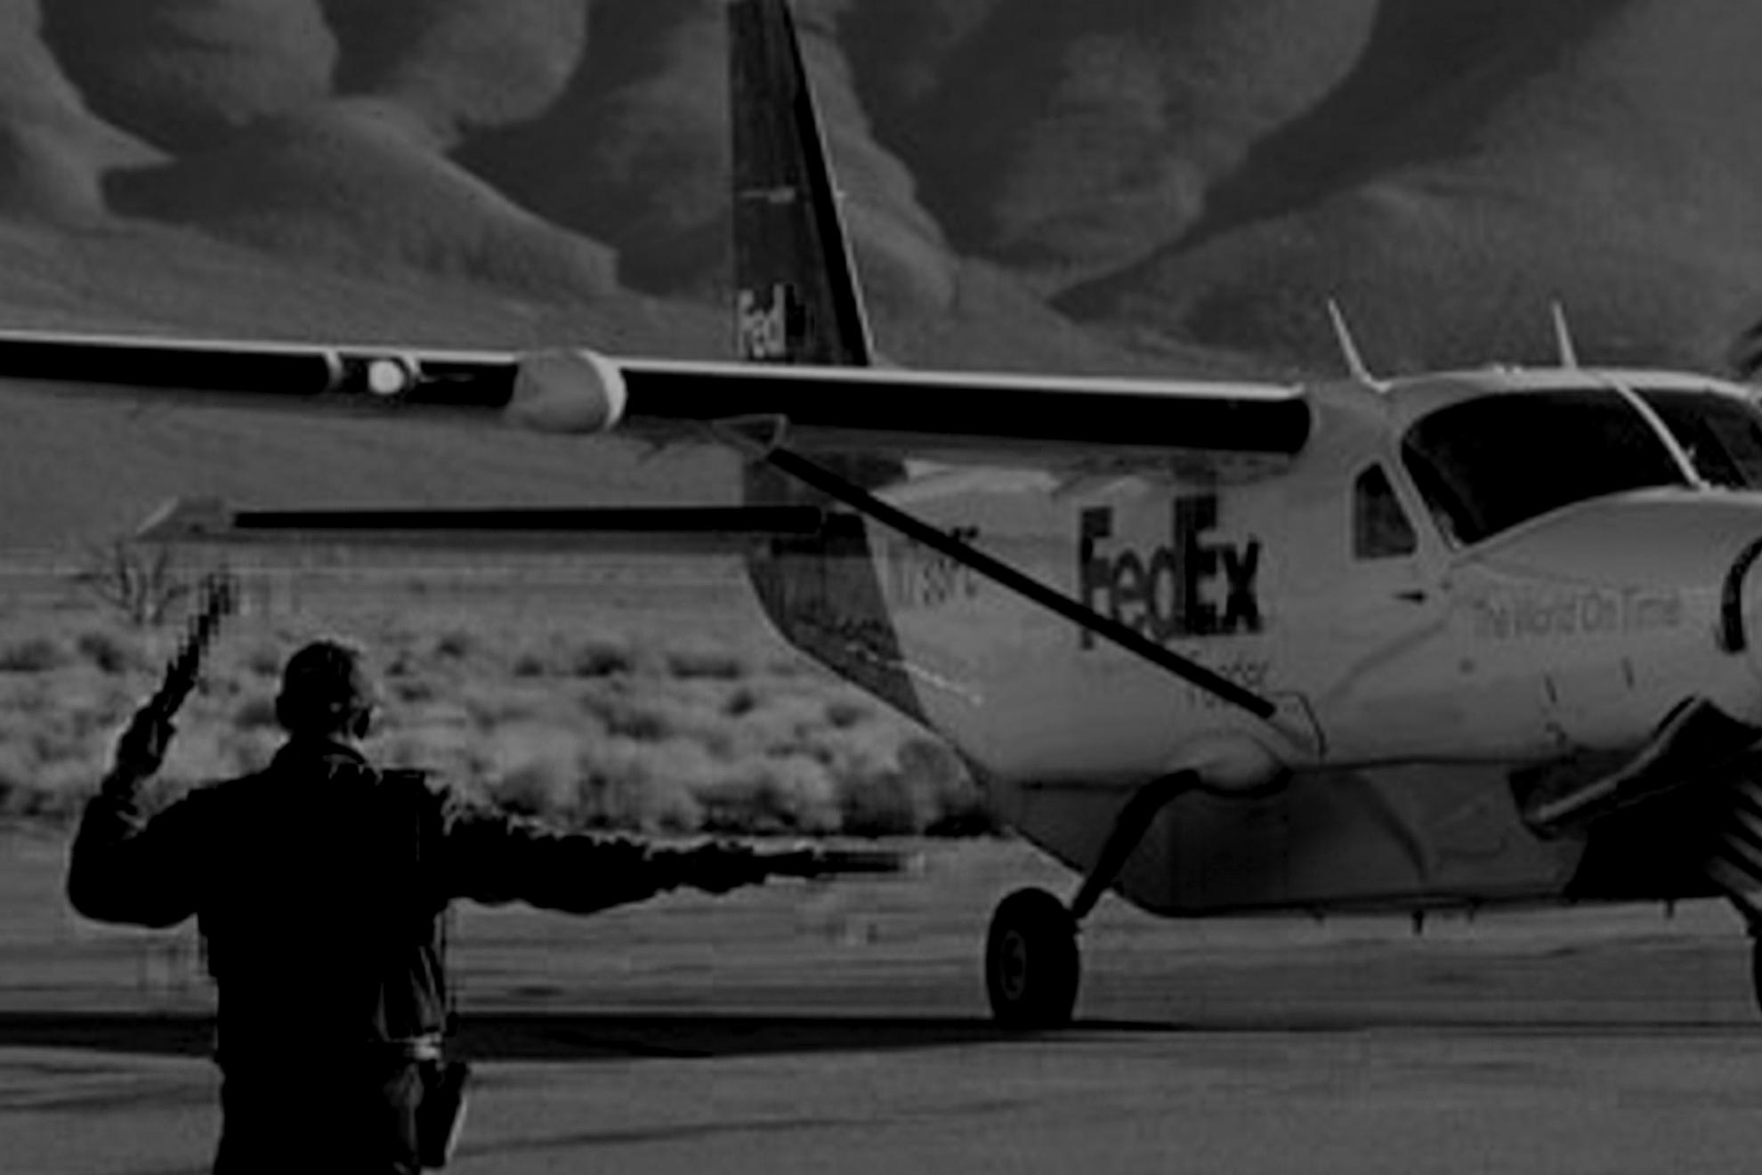
$292M
$7.4M
4
16
646
FY25 Revenue
FY25 Adj. EBITDA*
CORE SEGMENTS
COMPANIES
EMPLOYEES
COMMERCIAL AIRCRAFT ENGINES AND PARTS
DIGITAL SOLUTIONS
GROUND SUPPORT EQUIPMENT
OVERNIGHT AIR CARGO
*See Adjusted EBITDA reconciliation on slide 35
Notes:
Updated at end of Fiscal Year – ensure that any reference to another slide is up-to-date and correct as new slides are added/deleted.

Slide 10
FY Results
AIR T, INC. FY Financial Highlights
(For the Twelve-Month Period Ended 3/31)
 | 2025 | 2024 | 2023 | 2022 | 2021
Revenue | $291.9M | $286.8M | $247.3M | $177.1M | $175.1M
Operating Income | $1.9M | $1.3M | ($4.4M) | $8.8M | ($9.2M)
Adjusted EBITDA* | $7.4M | $6.2M¹ | $6.0M | $11.4M | ($1.3M)
*See Adjusted EBITDA reconciliation on slide 35
FY25 saw a 2% revenue increase compared to FY24. This includes a $7.3M decrease in Commercial Aircraft Engines and Parts, driven by a lower supply of whole assets available to purchase for tear-down and resale. Overnight Air Cargo increased by $8.5M, mainly due to higher pass-through revenues and admin fees. A higher volume of deicers to commercial customers and increase in spare part sales increased Ground Support Equipment Segment by $1.8M. Digital solutions revenue increased by $1.5M primarily due to increased software subscriptions.
FY25 Adjusted EBITDA increased by $1.2M. Overnight Air Cargo decreased by $0.3M in the current fiscal year due to lower segment operating income. Commercial Aircraft Engines and Parts increased by $3.7M due to a higher profit margin on component sales. Ground Support Equipment segment decreased by $0.2M due to higher sales and Digital Solutions segment decreased by $0.4M due to higher personnel costs.
¹ Includes addition of share-based compensation and severance expense adjustments to enhance comparability with current year’s presentation.

Slide 11
Commercial Aircraft Engines and Parts
SEGMENT 1
Twelve-Month Period Ended 03/31 | 2025 | 2024
Revenue | $118.2M | $125.5M
Adjusted EBITDA* | $9.8M | $6.1M
We buy aircraft and engines, then either lease, trade, or send them to part out.
We supply parts to maintenance, repair, and overhaul facilities (MRO).
Companies in this segment include Contrail, AirCo, AirCo Services, Worthington, Jet Yard, Air’Zona, and LGSS.
The decrease in revenue for this segment from the prior year was primarily driven by a lower supply of whole assets available to purchase for tear-down or resale.
The increase of $3.7M in adjusted EBITDA was driven by higher profit margins on sales.
*See Adjusted EBITDA reconciliation on slide 35
A niche between aircraft owners and MRO shops, this segment will seek to grow by coordinating activities.
Notes:
Revenue taken from Pg 3 of the Q filing - the phrasing below can be used in future iterations, will have to update based on any new information that comes about, particularly in the last blurb regarding the specific types of aircrafts. In the Q4 presentation, change to 12 month period ended 03/31, and update the figures accordingly.

Slide 12
Overnight Air Cargo
SEGMENT 2
Twelve-Month Period Ended 03/31 | 2025 | 2024
Revenue | $124.0M | $115.5M
Adjusted EBITDA* | $6.8M | $7.1M
We operate two of the nine FedEx feeder airlines in North America.
Business units Mountain Air Cargo and CSA Air have a 40+ year history with FedEx.
Air T Companies since 1982 and 1983
Air T added Worldwide Aircraft Services (WASI) to this segment in Q4 FY23.
The increase in revenue was principally attributable to higher labor revenues, increase in admin fees and higher FedEx pass through revenues due to higher billable hours for maintenance.
An asset-light, predictable business.
*See Adjusted EBITDA reconciliation on slide 35

Slide 13
Ground Support Equipment
SEGMENT 3
Twelve-Month Period Ended 03/31 | 2025 | 2024
Revenue | $38.9M | $37.2M
Adjusted EBITDA* | ($0.8M) | ($0.9M)
We manufacture deicing equipment, scissor lift trucks, and other ground support equipment.
Sole-source deicer supplier to the US Air Force for 20+ years.
Highly efficient light manufacturing facility.
The segment is comprised of Global Ground Support LLC.
Air T Company since 1998.
The increase in revenue was primarily driven by an increase in spare part sales and support services provided to customers while deicer sales increase slightly.
Segment’s order backlog was $14.3 million as of 03/31/25 compared to $12.6 million as of 03/31/24
*See Adjusted EBITDA reconciliation on slide 35
Notes:
Same comment as the previous two slides – Revenue information taken from Pg 3 of the Q – all of the bullet points below seem fit to be used in future iterations – will just have to amend the numerical figures in the charts. Same comment as previous slide. Backlog number in bottom right corner can be sourced from the K.

Slide 14
Digital Solutions
SEGMENT 4
Twelve-Month Period Ended 03/31 | 2025 | 2024
Revenue | $7.3M | $5.8M
Adjusted EBITDA* | ($0.3M) | $0.1M
Digital solutions develops and provides digital aviation and other business services to customers within the aviation industry to generate recurring subscription revenues. Digital solutions has historically been reported as part of the central corporate function referred to as Corporate and Other.
Adjusted EBITDA decreased by $0.4M in the current fiscal year driven primarily by higher personnel costs.
The increase in revenue is primarily due to increased software subscriptions driven by continued acquisition of new and recurring customers.
*See Adjusted EBITDA reconciliation on slide 35

Slide 15
SEGMENT 5
Corporate and Other Subcomponent of Operating Income
(excluding Equity Method Investments)
Twelve-Month Period Ended 3/31 | 2025 | 2024 | 2023 | 2022 | 2021
Corporate Overhead | ($5.9M) | ($3.1M)² | ($6.0M) | ($5.6M)¹ | ($5.4M)
Other subsidiaries³ | ($3.3M) | ($4.4M) | ($4.6M)⁴ | ($4.4M)⁴ | ($4.0M)⁴
Total Corporate and Other | ($9.2M) | ($7.5M) | ($10.6M) | ($10.0M)¹ | ($9.4M)
¹ Excludes one-time Employee Retention Credit of $9.1M. Reported FY22 Operating Income for the Corporate and Other segment was ($0.9M).
² In FY24, Air T refined its corporate allocation calculation, which increased business unit allocations by $2.7M
³ Consists of other consolidated businesses that are insignificant and do not fit cleanly into the Commercial Aircraft Engines and Parts, Overnight Air Cargo, Ground Support Equipment or Digital Solutions segments.
⁴ Digital solutions was included in other subsidiaries portion of operating income in FY21-23.
Notes:
Look into where this information is being sourced from – particularly where is the partitioning and breakdown of the information, is this being sourced from the Q, and if so where? It does not appear to be sourced from the Q – look into the supermodel and see if this information can be gleaned and extracted from anywhere in the model. Add 2025 figures and will likely remove the 2020 figures, but ensure that is the plan before doing so.

Slide 16
SEGMENT 5
Corporate Overhead Detail
Twelve-Month Period Ended 3/31 | 2025 | 2024 | 2023 | 2022 | 2021
Salaries & benefits | ($5.7M) | ($5.3M) | ($4.3M) | ($4.0M) | ($3.6M)
Audit, tax, legal and professional fees | ($1.8M) | ($1.5M) | ($1.9M) | ($2.5M) | ($1.3M)
Health insurance¹ | ($0.7M) | $0.7M | ($0.5M) | $0.1M | ($0.8M)
Other expenses² | ($3.0M) | ($2.3M) | ($2.0M) | ($1.8M) | ($2.1M)
Subtotal | ($11.2M) | ($8.4M) | ($8.7M) | ($8.2M) | ($7.8M)
Corporate allocations³ | $5.3M | $5.3M | $2.6M | $2.5M | $2.4M
Total Corporate Overhead | ($5.9M) | ($3.1M) | ($6.1M) | ($5.7M) | ($5.4M)
¹Net balance of actual health claims incurred versus allocated amount to participating business units
²Travel, entertainment, software, public company expenses, insurance, and other office expenses
³Shared services such as treasury, tax, financial reporting, IT, payroll & benefits processing, and executive functions
Notes:
The data that is housed here will be sent over from Kim via an excel sheet, and will have to be transferred over to this format.

Slide 17
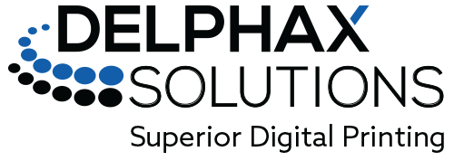
Investing For Growth
Investment manager focused on unearthing fundamentally attractive small and mid-cap opportunities. Allows us to further expand upon our idea generation capabilities to identify, analyze, develop and execute innovative investment strategies that are aimed at building better financial futures for all our stakeholders. Air T company since 2017.
Digital inkjet press designer and manufacturer, delivering color presses that produce high-quality output without compromising efficiency or budgets. Air T company since 2017.
Software developer and solution provider focused on the Aviation MRO and aftermarket community. Developed a suite of cloud-based and mobile applications to provide affordable, common-sense solutions. Air T company since 2018.
Notes:
Not taken from the Q – can be resused in future iterations if the belief is that it is a value add to the presentation as a whole.

Slide 18
Aircraft JVs
As of | 3/31/25 | 3/31/24 | 3/31/23 | 3/31/22
Aircraft JV Assets Under Management (net of dispositions) | $577M | $428M | $150M | $84M
Aircraft JV Assets Purchased | $632M | $429M | $150M | $84M
We manage assets for ourselves and our investor partners. The asset types include leased aircraft, consignments, and teardowns.
Our Aircraft JVs consist of the aircraft portfolio managed by Crestone Asset Management, LLC, as well as additional assets from other strategic partnerships.
Our Aircraft JVs receive standard aviation industry management fees, including origination fees, administrative fees, disposition fees, and an incentive fee above a certain hurdle rate (which varies by investment transaction).
Our Aircraft JV investors seek to generate 10%+ returns after fees.
Notes:
Not taken from the Q – this slide is likely very valuable and speaks well to the growth potential of this portion of the business, will need be amended with new figures in future iterations. Ben to show where this is sourced from. And updating 12/31/24 to 03/31/25 in Q4 presentation. Use quarterly figures in all other iterations.

Slide 19
BCCM Advisors
As of | 3/31/25 | 3/31/24 | 3/31/23 | 3/31/22
BCCM Assets Under Management | $26M | $37M | $33M | $43M
Air T‘s wholly-owned management company, BCCM Advisors, is the manager of a fund focused on growth “at-a-reasonable-price” US Equities, as well as a fund dedicated to equity compounders in Africa. BCCM also conducts ongoing research into new fund approaches.
Through 03/31/25, BCCM has not generated cumulative positive cash flows since inception.
Notes:
Similarly, not taken from the Q filing – likely sourced from the individual business unit – get clarity on this. Will also need to be amended with new data in future iterations of this presentation. Similar comment, Ben to show where this is sourced from.

Slide 20
Alerus Credit Agreement
On March 31, 2025, the Original Alerus Loan Parties under the Credit Agreement with Alerus entered into Amendment No. 3 to Credit Agreement with Alerus as well as a $3.0 million secured Overline Note and an Amended and Restated Revolving Credit Note in the amount of $14.0 million. The maturity date of the Overline Note is October 31, 2025 or such earlier date on which the Overline Note becomes due and payable. The Overline Note bears interest at the greater of 5.00% or one-month SOFR plus 2.00%. In connection with Amendment No. 3, AirCo, LLC, AirCo 2, LLC, AirCo Services, LLC, and Stratus AeroPartners, LLC were released as co-borrowers from the New Credit Agreement (including the Overline Note). As a result, only Air'Zona, CSA, GGS, MAC, WASI, Worthington, Jet Yard and Jet Yard Solutions remain as entities related to the Alerus note (the "Alerus Loan Parties")
NEWS
Runway Aero Advisors
On January 9th, 2025, AirT, Inc. announced the launch of a new business, Runway Aero Advisors LLC (“Runway”). Runway will advise companies as they raise debt and equity capital. Runway will be led by Steve Welo, who joined Air T in September 2024. Steve will continue to help Air T raise capital for its existing businesses, including Crestone Air Partners.

Slide 21
FINANCIAL HIGHLIGHTS
Over the last eleven years, revenue has increased 244% and is more diversified.
REVENUE
$288M*
3%
41%
+244%
$84M
43%
62%
38%
13%
*Excludes revenue in FY25 earned outside of our four core segments.
Notes:
This will be updated with Fiscal Year end figures.

Slide 22
OTHER
Non-Operating Assets
AIR T, Inc. owns the following public and private securities:
AIR T, INC. Non-Operating Assets (in millions) | 3/31/25 | 3/31/24 | 3/31/23 | 3/31/22 | 3/31/21
Lendway, Inc. (LDWY) Stock – 0.5M Shares¹ | $0.7 | $2.2 | $3.8 | $4.6 | $4.3
CCI Investment (20.1% as of 03/31/25)² | $3.9 | $3.7 | $3.1 | $2.6 | $3.8
Investments in BCCM Funds | $0.6 | $0.6 | $0.5 | $0.7 | $0.9
Aircraft Asset Management Investments³ | $14.3 | $10.5 | $8.2 | $7.0 | $0.0
Other Investments | $0.7 | $1.6 | $2.5 | $2.9 | $3.5
Total | $20.2 | $18.6 | $18.1 | $17.8 | $12.5
¹ Formerly Insignia Systems, Inc. (ISIG) ² Balances reflect the equity method of accounting at the specified period end.
³ Consists of the portfolio managed by Crestone Asset Management, LLC ("CAM"), as well as additional assets from other strategic partnerships
Notes:
Ben to show where to get the figures for this slide – update to show most recent quarter.

Slide 23
DISTRIBUTIONS
AIR T, INC. YTD FY25 Dividends Received from Equity Method Investees
(For the Twelve-Month Period Ended 3/31)
Equity Method Investment (in millions) | 2025 | 2024
Lendway | $0.0 | $0.0
CCI | $0.0 | $0.5
CAM | $4.9 | $2.2
Other | $1.5 | $0.5
Total | $6.4 | $3.2
Notes:
Sourced from Page 15 of 10-Q.

Slide 24
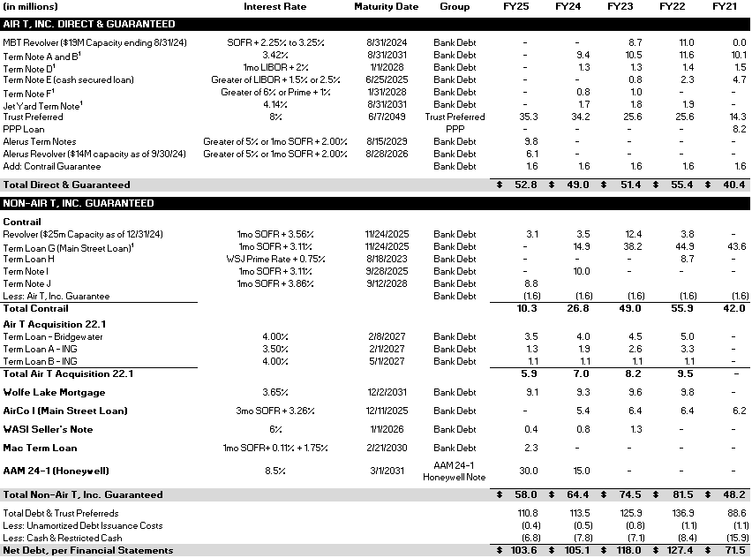
CAPITALIZATION TABLE
AIR T, INC.’s capital structure is designed to appropriately shape our bet sizes; in part by utilizing non-recourse leverage For example, AIR T guarantees Contrail’s bank loans to a maximum limit of $1.6 million.
¹The revolver and term notes with MBT were fully paid off with the proceeds from the new credit agreement with Alerus. The company terminated all commitments under the credit facility with MBT as of August 29, 2024.
Notes:
Debt Table Workbook in Back Office> Investor, can copy and paste based on new figures – ensure that “Group” heading is removed.

Slide 25
STRUCTURE
Calibrated Investments & Capitalization Structure
Tailored, Limited, Convex Exposures
Convexity-promoting organizational design
Kelly-calibrated investments: sized to edge & bankroll
Limit downside: tailored exposures
Risk Management: Downside Protection
Anti-fragile company
Islands of segregated assets and businesses
Market-driven and savvy risk management program that oversees all of the company

Slide 26
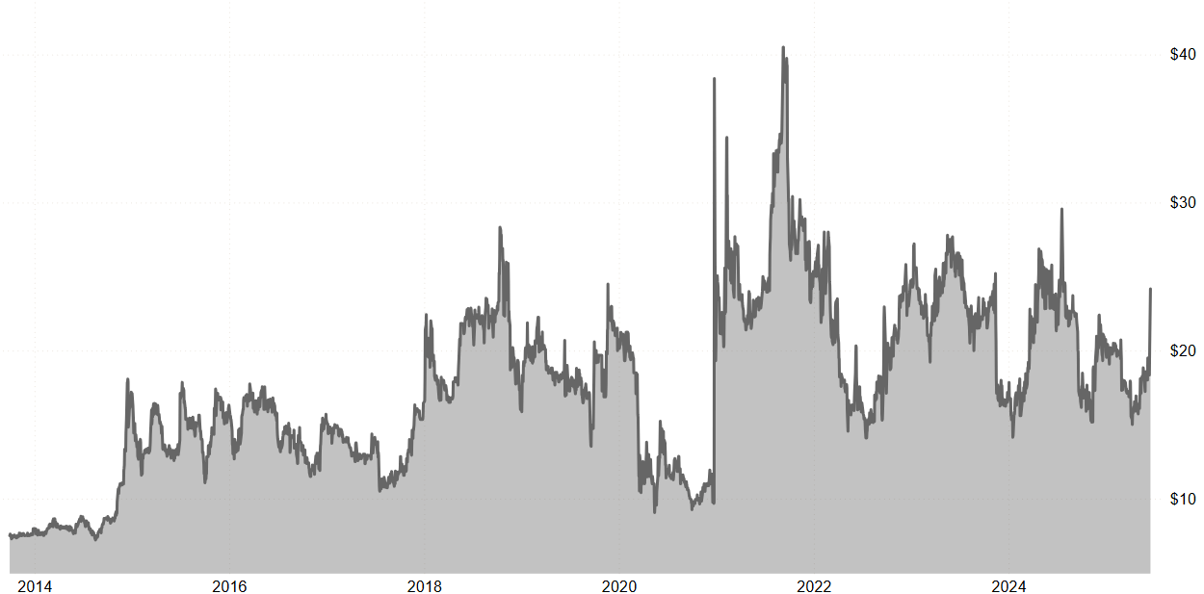
FINANCIAL HIGHLIGHTS
Since 12/31/2013, the share price of AIRT has increased by 11.1% per annum*⁺.
$24.16
⁺ Compares to 11.6% return of the S&P 500 over the same period
*Reporting period 9/30/13 to 6/16/25, includes $4M Trust Preferred dividend to common shareholders, paid August 12, 2022.
Notes:
Ben to show – perhaps a different way to present. PowerBI currently.

Slide 27
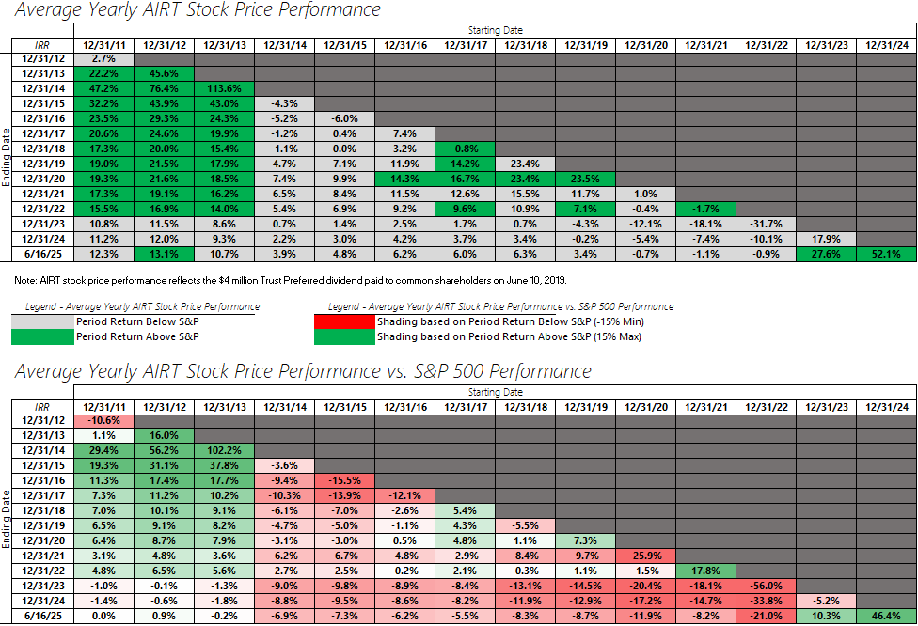
FINANCIAL HIGHLIGHTS
Notes:
Ben to show where to find the information needed for this slide. AIRT Returns is the source file – spend some time in here and ensure that you conceptually understand it.

Slide 28
GROWTH STRATEGIES

Slide 29
GROWTH STRATEGIES
Our four growth strategies are...
Invest to build our current high-performing businesses.
Seek to acquire new cash-flow generating businesses.
Identify great marketable securities or alternative assets.
Create unique investment products and fund alongside third-party capital partnerships.

Slide 30
GROWTH STRATEGY 1
We plan to reinvest in projects at our high-performing businesses by...
Purchasing commercial aircraft for trading, leasing and part-out.
Purchasing engine parts inventory.
Funding deicer builds for Global Ground Support.

Slide 31
GROWTH STRATEGY 2
We seek to acquire new cash-flow
generating businesses by...
Identifying and acquiring high-performing businesses, which either complement our current portfolio or diversify into industries beyond aviation.

Slide 32
GROWTH STRATEGY 3
We plan to identify great marketable securities or alternative assets by...
Searching for another committed activist opportunity.
Investing in distressed and high yield securities.
Investing in small cap securities.
Further investing in our current securities portfolio.

Slide 33
GROWTH STRATEGY 4
We plan to create unique investment products with outside capital partners by...
Offering thoughtful and sustainable products with attractive return profiles
Attracting and retaining sophisticated investment professionals and creating space for talented asset managers.

Slide 34
TOY MODEL
Theoretical Toy Model
Public Company versus Private Equity Fund
Question: Does a permanent capital vehicle like a public company have a structural advantage compared to a 7-year PE fund vehicle?
Hypothesis: For the straightforward reason that PE funds trade assets every 7 years, public companies tend to have a significant structural advantage at every timescale.
Complicating Factors:
Do annual corporate tax burdens of a public C-corporation differ from a company owned by a public company?
Does the inherent churn of buying and selling businesses within a public company overstate the advantage vs PE Fund?
Theoretically, the public company can buy and sell assets without regards to the calendar, therefore at better prices.
Cost and burden of being a public company.
ASSUMPTIONS
Annual Return on Investment | 5%
Taxes Paid by PE Fund @ 7-year Intervals | 30%
Year | Public Company $1 | Private Equity Fund $1 |  | Taxes Paid
0 | $1.00 | $1.00 |  | $0.00
7 | $1.34 | $1.24 |  | $0.10
14 | $1.89 | $1.59 |  | $0.15
21 | $2.65 | $2.04 |  | $0.19
28 | $3.73 | $2.63 |  | $0.25
35 | $5.25 | $3.38 |  | $0.32
42 | $7.39 | $4.34 |  | $0.41
49 | $10.40 | $5.57 |  | $0.53
 |  |  | Total | $1.96
Note: In this model we assume that assets are sold by the private equity fund every seven years and reinvested after paying capital gains taxes on the gain on the sale. It is also assumed that the Public Company does not sell the assets and therefore does not pay capital gains tax. The model does not consider taxes paid on operational results.
This projection, forecast or estimate is a forward-looking statement and an example only. It is based upon certain assumptions which are speculative in nature and may vary materially from actual results.

Slide 35
FY Results
Adjusted EBITDA Reconciliation
(For the Twelve-Month Period Ended 3/31)
 | 2025 | 2024 | 2023 | 2022 | 2021
Operating Income (GAAP) | $1.9M | $1.3M | ($4.4M) | $8.8M* | ($9.2M)
Depreciation (excluding leased engine depreciation) | $3.0M | $2.8M | $2.5M | $1.6M | $1.2M
Asset Impairment, write-downs, restructuring | $1.5M | $1.2M | $7.8M | $0.8M | $6.6M
Gain on sale of PP&E | $0.0M | $0.0M | $0.0M | $0.0M | ($0.0M)
TruPs Issuance Expenses & other | $1.0M | $0.9M¹ | $0.1M | $0.3M | $0.0M
Adjusted EBITDA | $7.4M | $6.1M | $6.0M | $11.4M* | ($1.3M)
*Includes one-time ERC credit of $9.1M
¹ Includes the addition of share-based compensation and severance expense adjustments to enhance comparability with current year’s presentation.
Notes:
Sourced from 10K in Non-GAAP Financial Measures section.

Slide 36
Q&A WITH MANAGEMENT
Notes:
Katrina to send any questions received and their corresponding answers.

Slide 37
Our interactive Q&A capability, through Slido.com, allows shareholders to ask questions of our management. Recently submitted questions have been answered below. To submit your own question, go to (https://app.sli.do/event/j8drfixw).¹
Can you explain how the equity method accounting of non-consolidated businesses increase despite high dividend distribution from them?
Under the equity method, the carrying value of an investment increases by our share of the investee’s earnings and/or any capital contributions we make, and it decreases by our share of losses and any dividends received. So, even if we receive significant dividends, the overall investment balance can still increase if the investee generates strong earnings and/or we make additional capital contributions.

Slide 38
Our interactive Q&A capability, through Slido.com, allows shareholders to ask questions of our management. Recently submitted questions have been answered below. To submit your own question, go to (https://app.sli.do/event/j8drfixw).¹
What’s the right way to value your collection of businesses, especially your non-consolidated businesses that’s presented using the equity method?
We cannot comment which valuation method is the right way to value our businesses. We look at each of our businesses as separate, stand-alone entities with their own earnings potential and valuation. Equity method investments are recorded in accordance with GAAP, based on our initial investment adjusted for our share of the investee’s earnings or losses and reduced by any distributions or impairments. These balances reflect our accounting interest in the investees.

Slide 39
Our interactive Q&A capability, through Slido.com, allows shareholders to ask questions of our management. Recently submitted questions have been answered below. To submit your own question, go to (https://app.sli.do/event/j8drfixw).¹
What is the EPS versus last year in the same quarter?
The FY25 (12 months ending 03/31/25) Earnings Per Share was -2.23 versus FY24 (12 months ending 03/31/24) of -2.42
Out of all of the subsidiaries you operate or own, can you talk about which one has the largest upside potential as you see it?
Per our corporate policy, we do not provide forecasts or projections nor do we make future-looking statements. However, when we evaluate our businesses and investments, current or potential, we are looking for opportunities with long-term potential, consistent with our investment horizon.
How should I think about the earnings potential for CAM? I assume earnings will be lumpy, but can you talk about the targeted return profile for your investments?
Our Aircraft JVs receive standard aviation industry management fees, including origination fees, administrative fees, disposition fees, and an incentive fee above a certain hurdle rate (which varies by investment transaction). Our Aircraft JV investors seek to generate 10%+ returns after fees.

Slide 40
APPENDIX
Risk Factors

Slide 41
For more detail and explanation, please see the Company’s public filings including its Form S-3 and prospectus supplements filed with the SEC.
SUMMARY RISK FACTORS
The purchase of securities of Air T, Inc., the “Company,” is highly speculative and involves a very high degree of risk. An investment in the Company is suitable only for persons who can afford the loss of their entire investment. Accordingly, in making an investment decision with respect to the Company’s securities, investors should carefully consider all material risk factors, including the risks, uncertainties and additional information set forth below as well as set forth in our most recent Annual Report on Form 10-K, Quarterly Reports on Form 10-Q, Currents Reports on Form 8-K, and our definitive proxy statements, all which are filed with the SEC. Additional risks not presently known or are currently deemed immaterial could also materially and adversely affect our financial condition, results of operations, business and prospects.
General Business Risks Market fluctuations may affect the Company’s operations. Rising inflation may result in increased costs of operations and negatively impact the credit and securities markets generally, which could have a material adverse effect on our results of operations and the market price of our Securities. We could experience significant increases in operating costs and reduced profitability due to competition for skilled management and staff employees in our operating businesses. Legacy technology systems require a unique technical skillset which is becoming scarcer. Security threats and other sophisticated computer intrusions could harm our information systems, which in turn could harm our business and financial results. We may not be able to insure certain risks adequately or economically. Legal liability may harm our business. Our business might suffer if we were to lose the services of certain key employees.
Notes:
All of this is boiler plate language that is included in Form S-3, check if it needs amending in future iterations.

Slide 42
For more detail and explanation, please see the Company’s public filings including its Form S-3 and prospectus supplements filed with the SEC.
SUMMARY RISK FACTORS
Risks Related to Our Segment Operations The operating results of our segments may fluctuate, particularly our commercial aircraft engine and parts segment. Our Overnight Air Cargo Segment is dependent on a significant customer. Our dry-lease agreements with FedEx subject us to operating risks. Because of our dependence on FedEx, we are subject to the risks that may affect FedEx’s operations. A material reduction in the aircraft we fly for FedEx could materially adversely affect our business and results of operations. Sales of deicing equipment can be affected by weather conditions. We are affected by the risks faced by commercial aircraft operators and MRO companies because they are our customers. Our engine values and lease rates, which are dependent on the status of the types of aircraft on which engines are installed, and other factors, could decline. Upon termination of a lease, we may be unable to enter into new leases or sell the airframe, engine or its parts on acceptable terms. Failures by lessees to meet their maintenance and recordkeeping obligations under our leases could adversely affect the value of our leased engines and aircraft which could affect our ability to re-lease the engines and aircraft in a timely manner following termination of the leases. We may experience losses and delays in connection with repossession of engines or aircraft when a lessee defaults. Our commercial aircraft engine and parts segment and its customers operate in a highly regulated industry and changes in laws or regulations may adversely affect our ability to lease or sell our engines or aircraft. Our aircraft, engines and parts could cause damage resulting in liability claims. We have risks in managing our portfolio of aircraft and engines to meet customer needs. Liens on our engines or aircraft could exceed the value of such assets, which could negatively affect our ability to repossess, lease or sell a particular engine or aircraft. In certain countries, an engine affixed to an aircraft may become an addition to the aircraft and we may not be able to exercise our ownership rights over the engine. Higher or volatile fuel prices could affect the profitability of the aviation industry and our lessees’ ability to meet their lease payment obligations to us. Interruptions in the capital markets could impair our lessees’ ability to finance their operations, which could prevent the lessees from complying with payment obligations to us.

Slide 43
For more detail and explanation, please see the Company’s public filings including its Form S-3 and prospectus supplements filed with the SEC.
SUMMARY RISK FACTORS
Risks Related to Our Segment Operations (continued) Our lessees may fail to adequately insure our aircraft or engines which could subject us to additional costs. If our lessees fail to cooperate in returning our aircraft or engines following lease terminations, we may encounter obstacles and are likely to incur significant costs and expenses conducting repossessions. If our lessees fail to discharge aircraft liens for which they are responsible, we may be obligated to pay to discharge the liens. If our lessees encounter financial difficulties and we restructure or terminate our leases, we are likely to obtain less favorable lease terms. Withdrawal, suspension or revocation of governmental authorizations or approvals could negatively affect our business. Risks Related to Our Structure and Financing/Liquidity Risks Our holding company structure may increase risks related to our operations. A small number of stockholders has the ability to control the Company. Although we do not expect to rely on the “controlled company” exemption, we may soon become a “controlled company” within the meaning of the Nasdaq listing standards, and we would qualify for exemptions from certain corporate governance requirements. An increase in interest rates or in our borrowing margin would increase the cost of servicing our debt and could reduce our cash flow and negatively affect the results of our business operations. Our inability to maintain sufficient liquidity could limit our operational flexibility and also impact our ability to make payments on our obligations as they come due. Future cash flows from operations or through financings may not be sufficient to enable the Company to meet its obligations. A large proportion of our capital is invested in physical assets and securities that can be hard to sell, especially if market conditions are poor. To service our debt and meet our other cash needs, we will require a significant amount of cash, which may not be available. If our cash flows and capital resources are insufficient to fund our debt service obligations, we may be forced to seek alternatives. Despite our substantial indebtedness, we may incur significantly more debt, and cash may not be available to meet our financial obligations when due or enable us to capitalize on investment opportunities when they arise. Our current financing arrangements require compliance with financial and other covenants and a failure to comply with such covenants could adversely affect our ability to operate.

Slide 44
For more detail and explanation, please see the Company’s public filings including its Form S-3 and prospectus supplements filed with the SEC.
SUMMARY RISK FACTORS
Risks Related to Our Structure and Financing/Liquidity Risks (continued) Future acquisitions and dispositions of businesses and investments are possible, changing the components of our assets and liabilities, and if unsuccessful or unfavorable, could reduce the value of the Company and its securities. We face numerous risks and uncertainties as we expand our business. Our business strategy includes acquisitions, and acquisitions entail numerous risks, including the risk of management diversion and increased costs and expenses, all of which could negatively affect the Company’s ability to operate profitably. Strategic ventures may increase risks applicable to our operations. Rapid business expansions or new business initiatives may increase risk. Our policies and procedures may not be effective in ensuring compliance with applicable law. Compliance with the regulatory requirements imposed on us as a public company results in significant costs that may have an adverse effect on our results. Deficiencies in our public company financial reporting and disclosures could adversely impact our reputation. Risks Related to Air T Funding The ranking of the Company’s obligations under the Junior Subordinated Debentures and the Guarantee creates a risk that Air T Funding may not be able to pay amounts due to holders of the Capital Securities. The Company has the option to extend the Capital Securities interest payment period. Tax event or investment company act redemption of the Capital Securities. The Company may cause the Junior Subordinated Debentures to be distributed to the holders of the Capital Securities. There are limitations on direct actions against the Company and on rights under the guarantee. The covenants in the Indenture are limited. Holders of the Trust Preferred Securities have limited voting rights.

